Slide 1
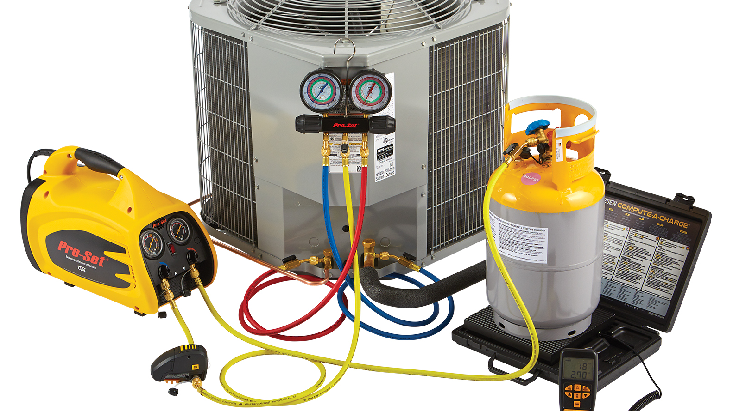

HVAC – 100P1
DX – System (Level 1)
(Direct Expansion) Practical

Slide 2
THE
AGENDA
01
02
03
04
Basic Refrigeration Cycle understanding
DX – System familiarization
Tool Identification and use
Process – Recovery of refrigerant
05
06
07
08
Process – Leak testing using nitrogen gas
Process – Vacuum of system
Process – Charging of refrigerant
Final Assessment

Slide 3
Introduction of participants and Trainer
Zakiuddin Soheel Mohammed
Trainer - L&D
Mohammed.Zakiuddin@enova-me.com
P.O. Box 22707; 2nd Floor City Centre Offices, Deira City Centre Complex, Dubai | United Arab Emirates www.enova-me.com

Slide 4
Objective NO 1
Objectives
To have a basic understanding of DX – sytem and have hands on exercise on different units
Objective NO 2
To have basic knowledge of HVAC tools and their useage
Objective NO 3
To perform the different process like refrigerant recovery, leak test, vacuum of system and charging of the refrigarant

Slide 5

Low Pressure
High pressure
1
compressor
evaporator
condenser
Area of vapor
Area of liquid
Expansion valve
TC

Slide 6
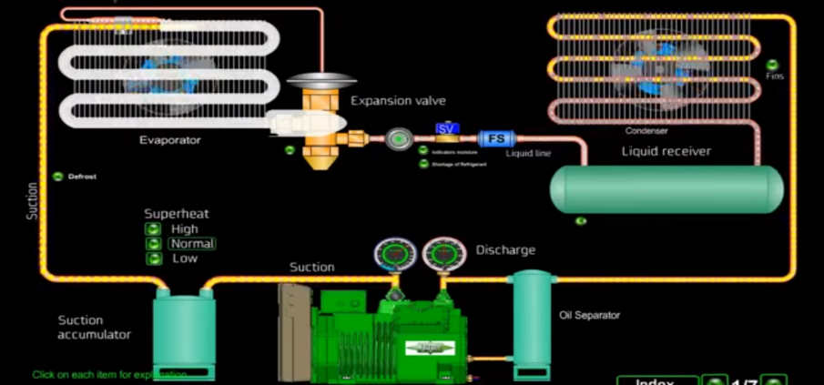

Slide 7
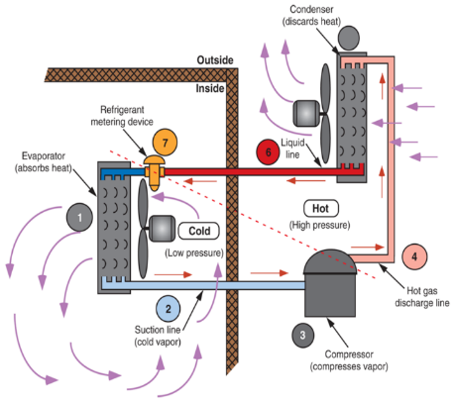
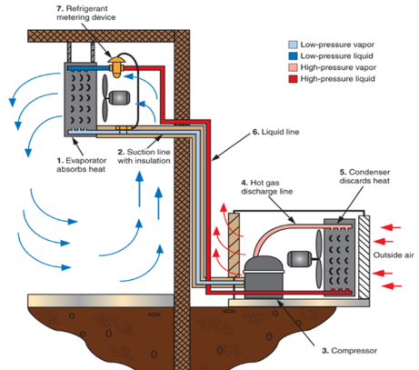

Slide 8
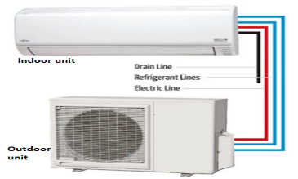
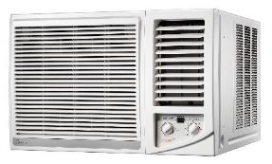
2
DX – System familiarization
Window AC
Split Unit

Slide 9
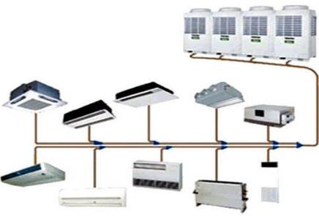
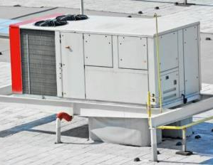
VRV / VRF System
2
Package Unit

Slide 10
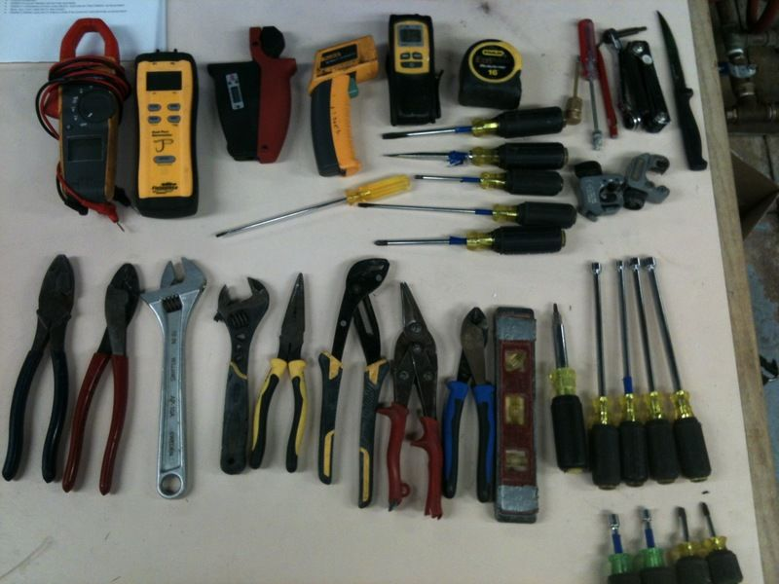
3
Tool Identification
Common tools for an AC – Technician
Tool Bag,
Variety of screwdrivers and nut-drivers,
Tubing cutters,
Crescent Wrenches & Allen Wrench Set,
Good pair of wire strippers & Hammer,
Multi – Meter,
Refrigeration gauges,
Infrared digital / digital thermometer
and magnetic tip tape measure.

Slide 11
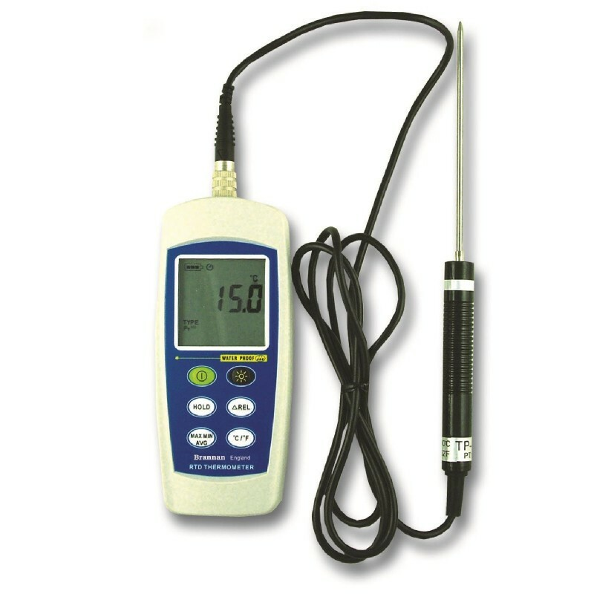
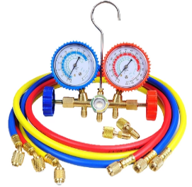
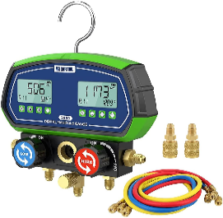
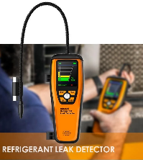
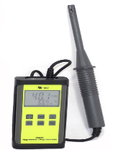
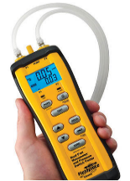
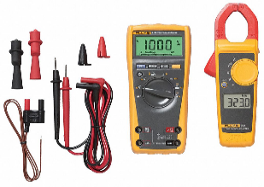
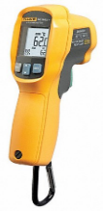
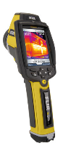
Temperature probe
Manifold Gauge
Digital Manifold Gauge
Hygrometer
Dual port manometer
Infrared Temp Gun
Multi Meter
Thermal Imager

Slide 12
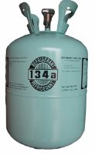
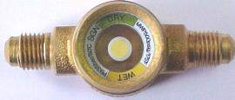
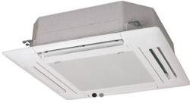
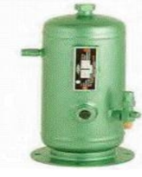
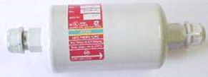
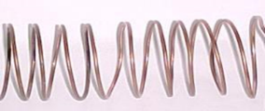
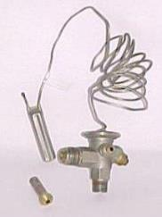
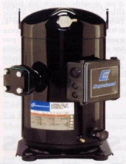
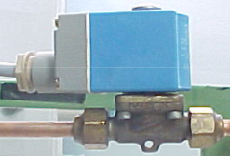
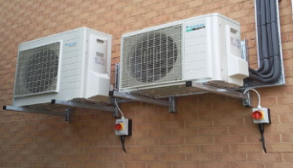
Sight Glass
Evaporator
Refrigerant cylinder
Filter Drier
Oil Separator
Capillary tube
Solenoid valve
Condenser
Compressor
Thermostatic expansion valve

Slide 13
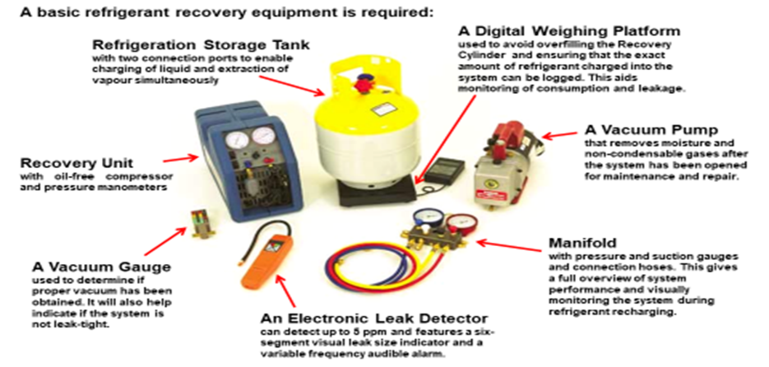

Slide 14
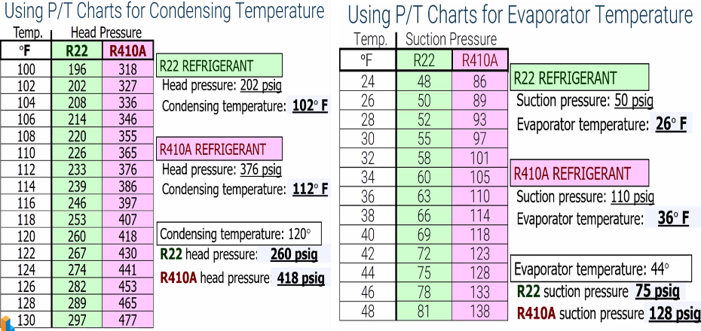

Slide 15
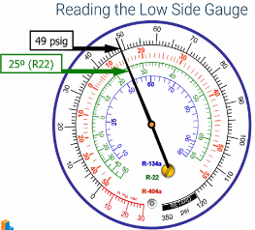
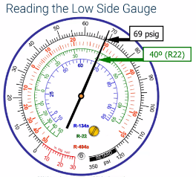
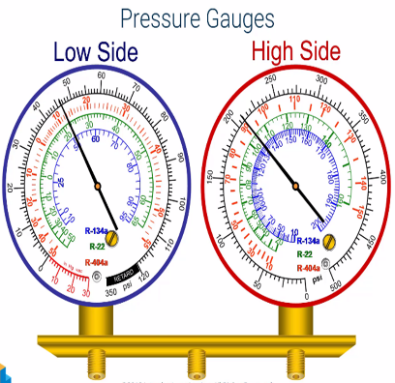
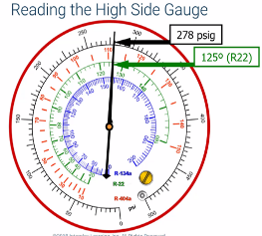
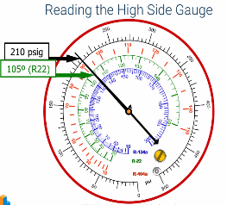

Slide 16
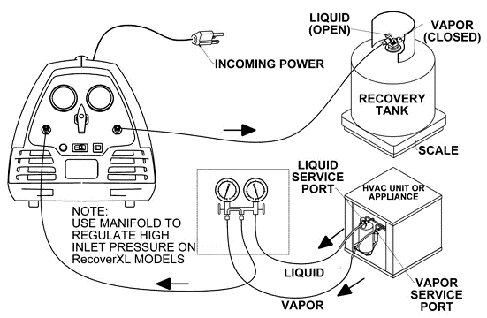
4
Refrigerant Recovery

Slide 17
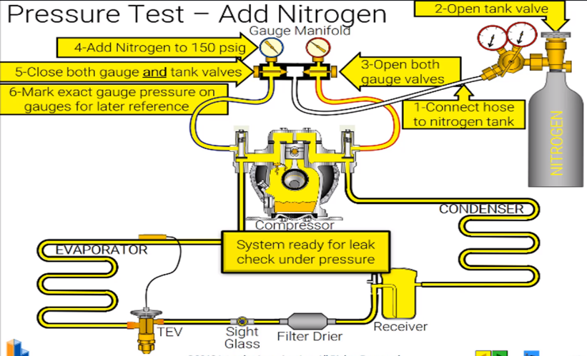
5

Slide 18
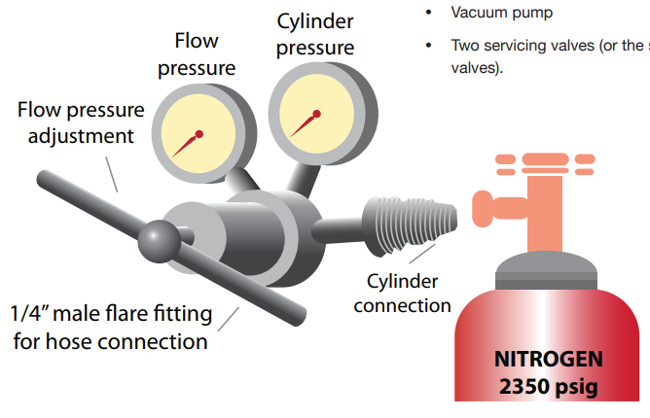
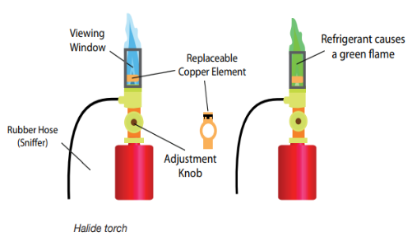
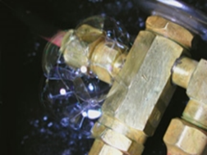
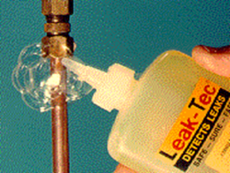
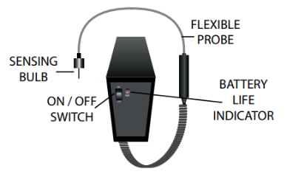

Slide 19
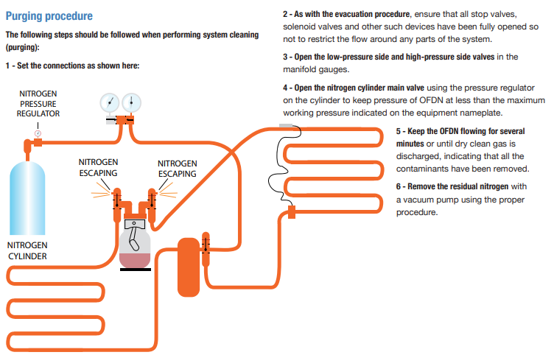
Oxygen Free Dry Nitrogen (OFDN)

Slide 20
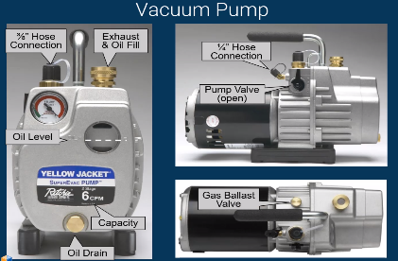
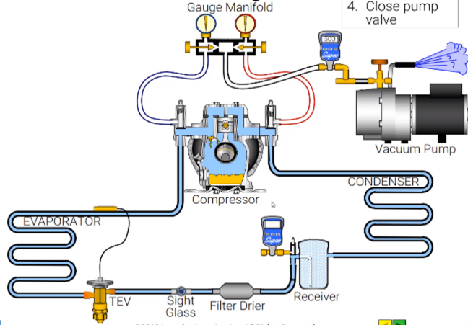
6

Slide 21
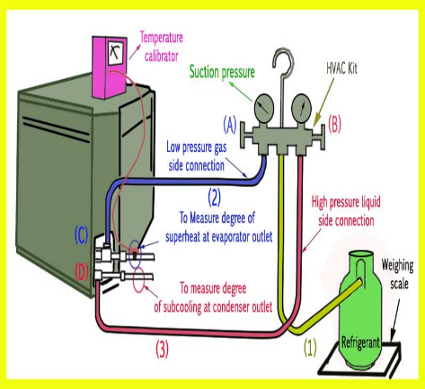
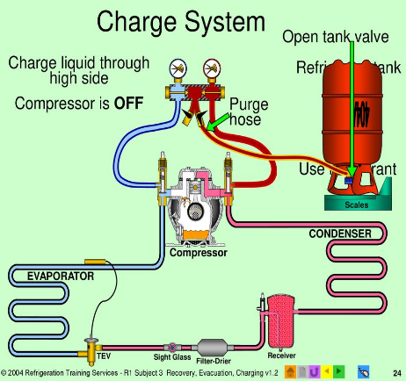
7

Slide 22
8
Final Assessment – Practical
Perform Recovery of refrigerant
Perform steps for leak test
Perform proper Vacuum of the system
Charge the Refrigerant

Slide 23
8
Final Assessment
Color code of Hose used for low pressure side
.
Yellow
Green
Red
Blue
Performing recovery of refrigerant is unnecessary activity which need to be avoided
True
False
Why we do the vacuum
to recover the refrigerant
to remove moisture and air
to do leak test
to remove carbon
To perform leak test we pressurize the system with
Hydrogen
Oxygen
Chlorine
Nitrogen

Slide 24
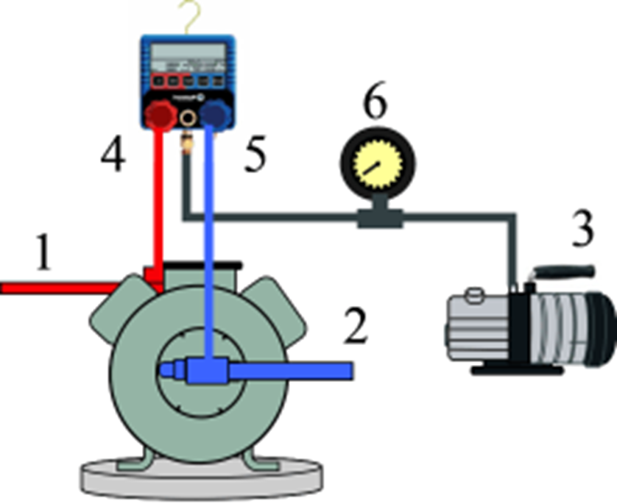
8
Final Assessment
Name the following connection points
.
1.________________
2.________________
3.________________
6.________________

Slide 25
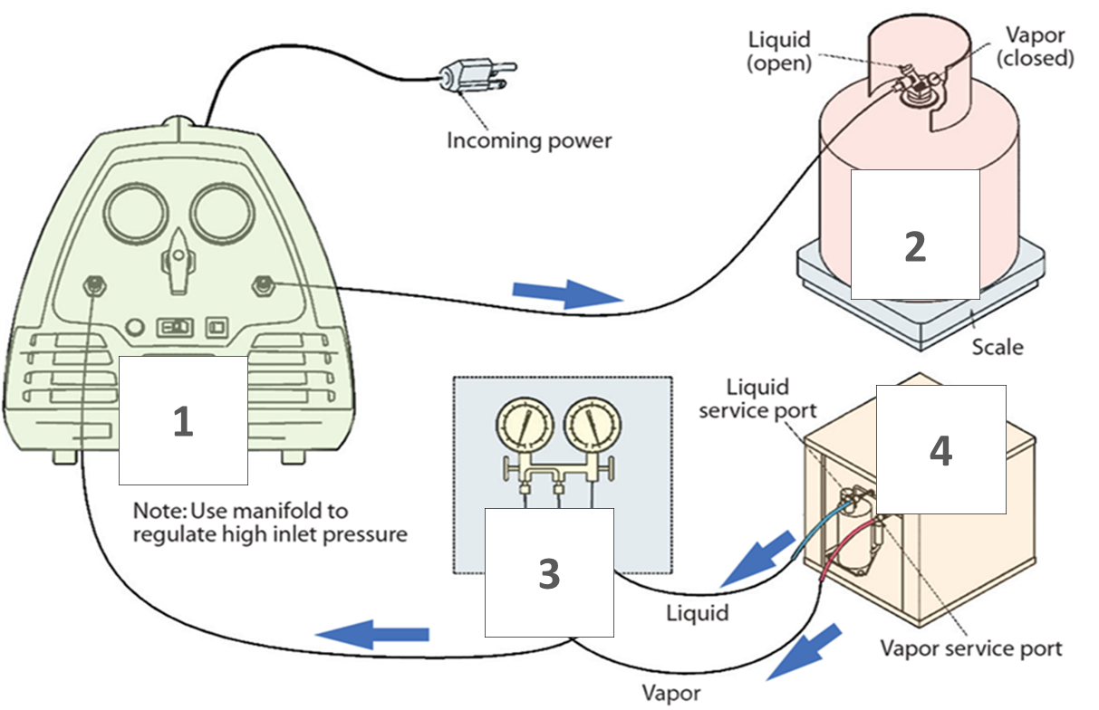
8
Final Assessment
Name the Devices
.
1.________________
2.________________
3.________________
4.________________

Slide 26




THANK YOU FOR YOUR ATTENTION
For more information:
www.enova-me.com

